Slide 1
Scaffolding Middle School Science Learning with Contrasting Cases
Alicia Chang
Timothy J. Nokes
Christian D. Schunn
University of Pittsburgh

Slide 2
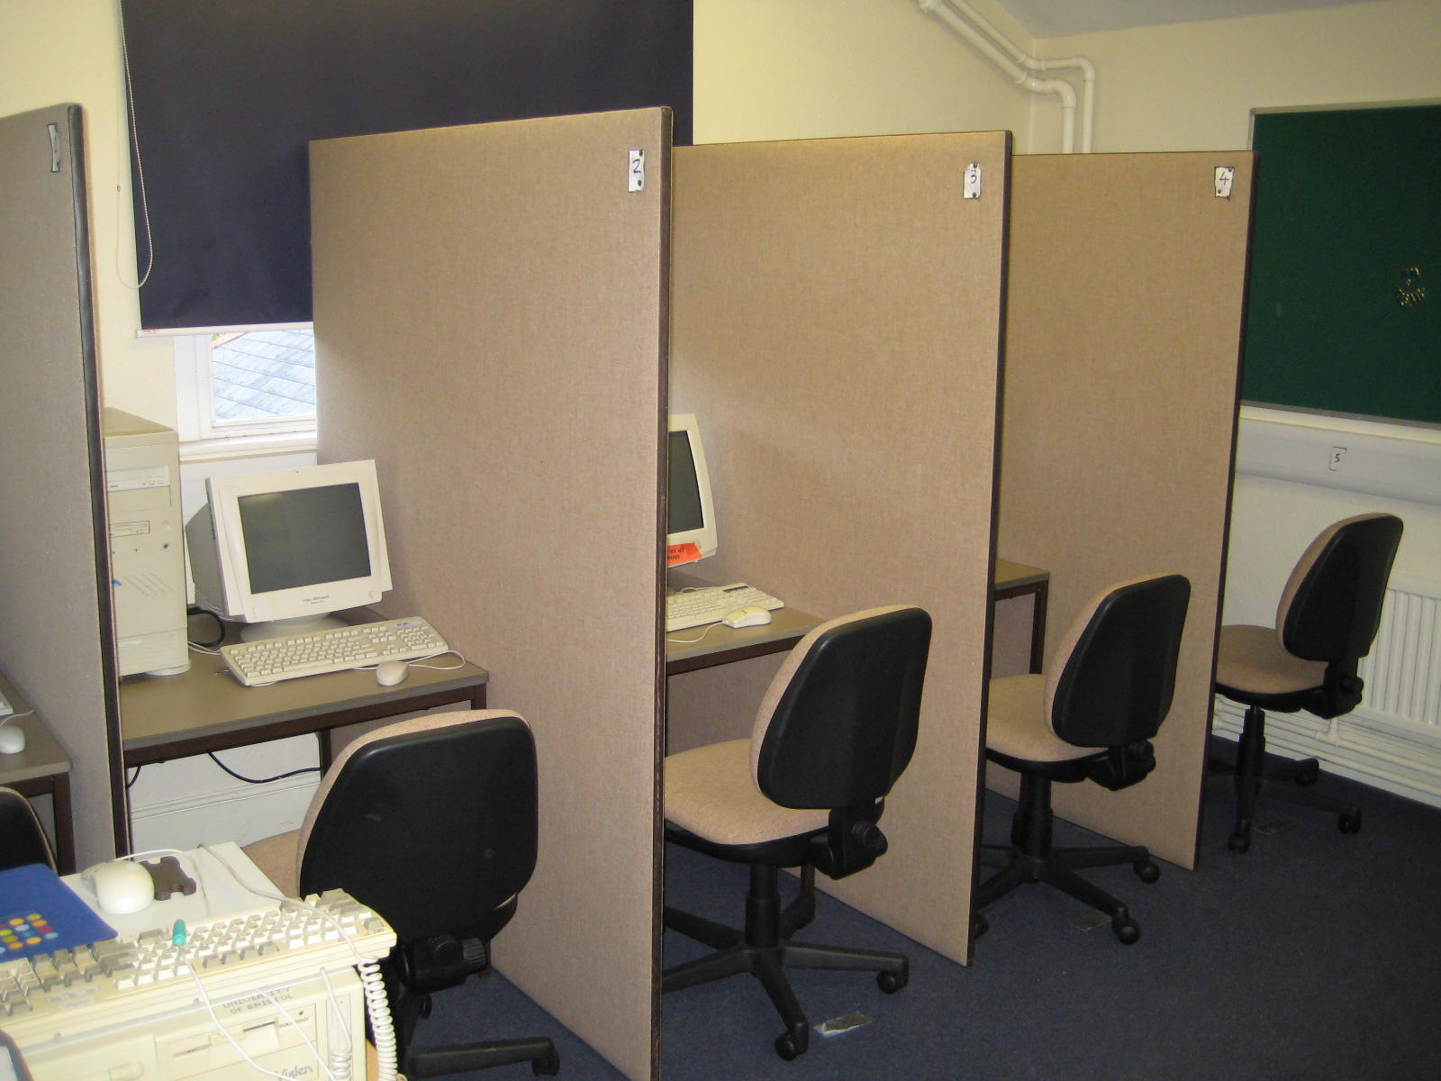
Laboratory

Slide 3
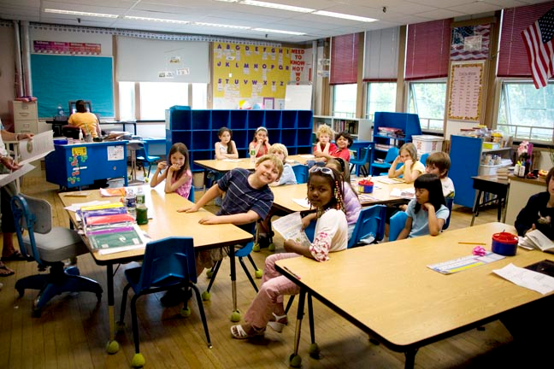
Classroom

Slide 4
The 21st Century Center for Research and Development for Cognition and Science Learning
Collaborators:
University of Pittsburgh (LRDC)
Temple University (SILC)
University of Pennsylvania (IRCS and GSE)
21st Century Partnership for STEM Education (MSPGP)
Research for Better Schools
Goals:
Make large improvements in student learning in the near run
Be a more general demonstration of how cognitive science might be used to improve science curricula at all levels.

Slide 5
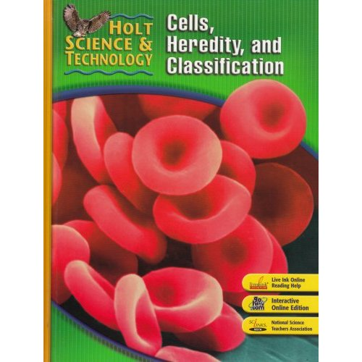
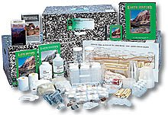
Curricula: Holt and FOSS

Slide 6
Core Cognitive Science Principles
Analogical reasoning (University of Pittsburgh)
Diagrammatic reasoning (Temple University)
The role of background knowledge (University of Pennsylvania)

Slide 7
Focal research questions
How are the three principles useful across curricular content and type?
Can systematic and systemic modifications using these three principles produce improvements in student learning?

Slide 8
Analogical reasoning
A core process that underlies conceptual learning and problem solving (Gentner, Holyoak, & Kokinov, 2001).
In math and science, students rely on prior cases and examples to solve new problems (Anderson, Greeno, Kline, & Neves, 1981; Ross, 1984; VanLehn, 1990).
A route to schema acquisition and generalized knowledge structures (Gick & Holyoak, 1983; Nokes & Ross, 2007; Ross & Kennedy, 1990).

Slide 9
Contrasting Cases
Schema acquisition has been found to be facilitated by a number of factors:
Increasing number of examples (Gick & Holyoak, 1983)
Increasing variability of examples (Nokes & Ohlsson, 2005; Paas & Merrienboer, 1994)
Instructions to focus learner on commonalities between examples (Cummins, 1992; Gentner et al., 2003)
Focusing learner on sub-goals (Catrambone, 1996, 1998)
Minimizing cognitive load (Ward & Sweller, 1990)

Slide 10
Scaffolding Science Learning
Comparison and contrast guides learners to similar and different features.
Understanding similarities and differences can help learners focus on the importance of these specific features.
Contrasting cases:
Can improve understanding through highlighting features
Provide opportunity to self-explain, make inferences
Can improve scientific reasoning skills
Can prepare students for future learning

Slide 11
Participants
180 middle schools (Pittsburgh, Philadelphia, Phoenix, Tucson)
2 curricula x
3 conditions x
30 schools/condition =
72,000 students
Control group
Limited Treatment
Full Treatment

Slide 12
CaSE Study
Applying cognitive science principles to existing curricula
“Contrasting cases” lead students through guided comparison of key concepts
Contrasting case usually 1-2 day lesson, inserted directly before existing lesson begins

Slide 13
Hypotheses
Inserting contrasting cases into curricula will improve student learning of concepts addressed in CC compared to no CC
Students will also be better prepared to learn from existing materials that follow CC

Slide 14
Developing a contrasting case
Identify critical concepts of lesson
Emphasize concepts through comparison
Notes:
Holt, Rinehart and Winston’s Cells, Heredity and Classification.
First emphasize two examples of the first concept; have students extract key structural features of concept while de-emphasizing superficial details that might distract from concept. Then present two examples of second concept, follow same process. Then across concepts.

Slide 15
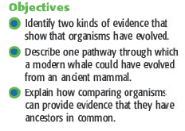
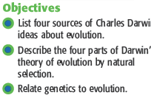
Chapter overview: Evolution of Living Things
Holt, Rinehart & Winston, 2004

Slide 16
Within comparison: Part 1

Slide 17
Within comparison: Part 1

Slide 18
Compare selective breeding
Notes:
Within comparisons help students focus on the critical features of the category, abstract away from details of case. In this comparison, emphasizes traits vary, humans select

Slide 19
Within comparison: Part 2

Slide 20
Within comparison: Part 2

Slide 21
Compare natural selection
Notes:
Emphasize traits vary, nature “selects” based on rate of successfully reproducing and offspring surviving to adulthood

Slide 22
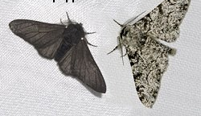
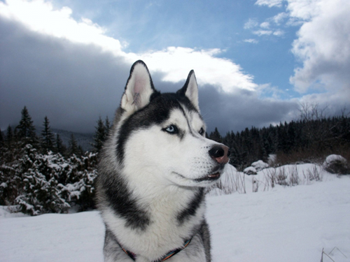
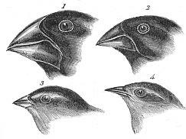
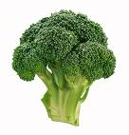
Between-category comparison
Natural Selection
Selective Breeding
Similarities?
Differences?
Notes:
Same: traits vary
Different: Mechanism determining which get to reproduce

Slide 23
Preparation for existing lesson

Slide 24
Direct learning measure
Material covered in contrasting case:
Which of the following is NOT an example of natural selection?
a. people breeding horses to run faster*
b. bacteria populations becoming resistant to antibiotics
c. insect populations developing resistance to certain pesticides
d. male birds of certain species developing colorful feathers to attract female mates
Material covered in lesson that follows:
The fact that an organism’s offspring are not identical is known as
a. adaptation.
b. inherited variation.*
c. reproduction.
d. genetics.

Slide 25
Dependent Variables
8th grade science assessments:
Arizona
Pennsylvania
Constructed assessment using public release items (e.g., NAEP, TIMSS, state tests)
Holt
FOSS

Slide 26
Predictions
The three cognitive science principles chosen have been widely applied across multiple domains and contexts.
These ideas are likely to lead to:
increased self-regulated learning
Near and far transfer to other scientific topics and domains
Thus, we predict differences in achievement on assessments between the Treatment Groups and the Control group.

Slide 27
Implications
This program of research has the potential to yield benefits for society in several ways:
It may increase the STEM educational and workforce pipline
Build a science-informed citizenry
Improve personal health decisions
Build the scientific research base on teaching our chosen cognitive principles
This program will also elucidate how principles of cognitive science can be used for education improvement.

Slide 28
Acknowledgments
CogSci Team
Collaborators
Chris Schunn
Tim Nokes
Liz Richey
Kalyani Raghavan
Mary Sartoris
Christine Massey
Jennifer Cromley
Nora Newcombe
Donna Cleland
Joe Merlino
Andy Porter
Laura Desimone

