Slide 1
Middle School Biology
Increasing Student Learning
Through Increasing Teacher Content Knowledge
Bates Mandel
Susan Holmes
21st Century Partnership for STEM Education
2012 NSTA Convention

Slide 2
Presentation Goals
Introduce and review the Middle School Science Research study
Provide a brief view of biology activities used in the content arm of the research

Slide 3
The Work
Can the application of cognitive science principles to existing curriculum materials make a difference in students’ learning of science?

Slide 4
The Work
Can the deepening of teacher content knowledge make a difference in students learning of science?

Slide 5






The Partners
Temple University

Slide 6
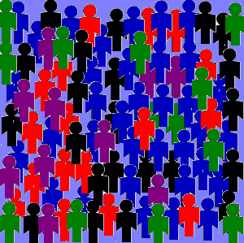
Randomization
Assignment of a teacher to the experimental or control condition is equally likely by chance. A Randomized Control Study
  Each district within the study was divided into thirds
Experimental Condition 1 (content pd)
Experimental Condition 2 (content + cog sci pd)
Randomization
Control Condition
Random assignment establishes fair comparisons.

Slide 7
Experimental Design
Science Content Arm
Cognitive Science Arm
Does deepening teachers’ knowledge of the science they are teaching lead to increased student achievement?
Does giving teachers science unit materials modified using cognitive principles and providing professional development on how to implement the modifications lead to increased student achievement?
Control Group

Slide 8
Design Limitations
Science Content Arm
Cognitive Science Arm
PD is focused on ADULT learning. It does not include discussion of students or activities to use with students
Teachers decide how to teach their lessons as a result of what they learned in PD
PD is focused on STUDENT learning. Discussion of student learning and activities to use with students are given
Teachers must use the modified materials as they are given in PD

Slide 9
Professional Development
PD Package
These three days of intensive summer work as a beginning of the professional development
Four important after school follow up sessions in Professional Learning Communities (PLCs) of teachers

Slide 10
Baseline Measures/Covariates
Several measures will be collected at the start of the study to help improve our ability to estimate outcomes at the end of the study:
  Student demographic data
  Student achievement data in math and reading assessments will be collected for all participating students for the two years prior to the start of the study

Slide 11
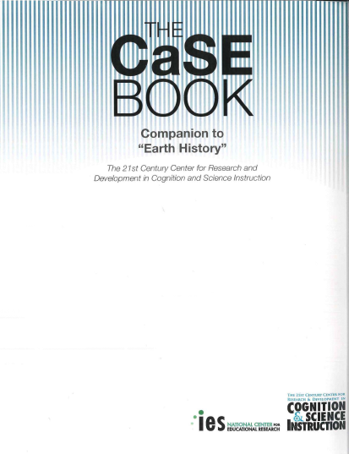
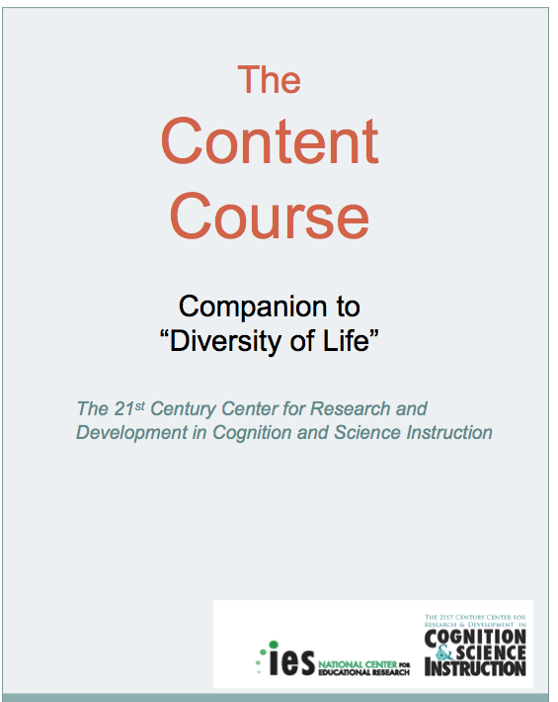
Binders
Cognitive Science
Content

Slide 12
Outcomes
  All teachers in all three arms of the study will administer the end of unit test to their students.
Will also use 8th grade state science (PSSA or AIMS) scores as a measure of student learning.
All teachers in all three arms of the study are paid to take:
  The Survey of Enacted Curriculum (SEC)
  The Teacher Content knowledge test
  A short spatial ability test

Slide 13
School Districts Involved with Study
Holt Text Book
School District of Philadelphia
Approx. 90 total schools – 30 in each arm of the study
Grades 7 & 8
Foss Science Kits
Pittsburgh Public Schools
Phoenix Area School Districts
  Dysart, Deer Valley, Madison, and Buckeye
Tucson Area School Districts
  Tucson Unified SD, Sunnyside
Approx. 90 total schools – 30 in each arm of the study
Grades 6 & 7
Each Content Unit/Grade will
be done for two consecutive years

Slide 14
Study Overview
Baseline
Intervention
Teaching of Unit
Outcomes
Prior student achievement
Use of Curriculum
Pedagogical Approach
Use of Content & Cognitive Science PD
Control
School Characteristics
Increased Student Learning
Content PD
Teacher Background
Cognitive Science + Content PD

Slide 15
Units Under Study
Holt Text Book
Biological Science Unit | Earth Science Unit | Physical Science Unit
Cells, Heredity and Classification | Inside Restless Earth | Introduction to Matter

Slide 16
Units Under Study
Foss Kits
Biological Science Unit | Earth Science Unit | Meteorological Science Unit
Diversity of Life | Earth History | Weather & Water
Notes:
16

Slide 17
Content Curriculum Covered
Holt Text Book – Cells, Heredity and Classification
Cell Structure
Cell Function
Heredity
Evolution
Geologic Time/History of Life on Earth
Classification/Taxonomy
Foss Kit – Diversity of Life
What is Life
Microscopic Life
Cell Structure and Function
Plant Structure and Function/Plant Reproduction
Animal Structure and Function (Snails/Roaches)
Classification/Taxonomy
(Evolution/Ecology)

Slide 18
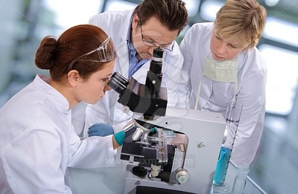
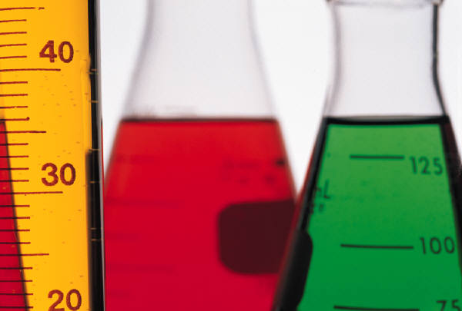
SMILE ☺
YOU ARE IN A RESEARCH STUDY

Slide 19
QUESTIONS or CONCERNS??

Slide 20
Taxonomy: Phylogeny Reconstruction
Taxonomy: Phylogeny Reconstruction
Developed by Drs. Amy Faivre and Audrey Ettinger, Cedar Crest College
Systematists are evolutionary biologists who try to determine how organisms are related to one another. Today you get you try to figure out how to approach this problem, using fruits as model organisms.
1. Before you are 6 fruits: apple, avocado, orange, pear, plum and peach. Begin by considering some characteristics of the fruits that might be useful in terms of evolution (the morphological characteristics that you use to differentiate among organisms are correctly called Characters) Think about why plants make fruits. You may want to cut the fruits open to consider the inside when identifying characters. More characters will lead to a more accurate tree – can you think of at least four characters?
2. Now that you have determined some characters that differ among the fruits, determine the character state for each character for each fruit. Character states are the different forms of each character for each species. For example, if you were comparing 5 species of fish, you might use the character of fin shape to distinguish them. The different character states of fin shape might be round, elongated, triangular, and oval.
3. You are now ready to begin arranging your fruits into a phylogeny, a tree representing the evolutionary relationships among these fruits. First, can you determine which fruit might qualify as an outgroup, an ancestor to all of the other fruits? An outgroup fruit would have the least number of characteristics in common with any of the other fruits. Choose a likely candidate and place it at the bottom of your tree.

Slide 21
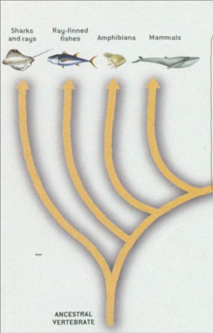
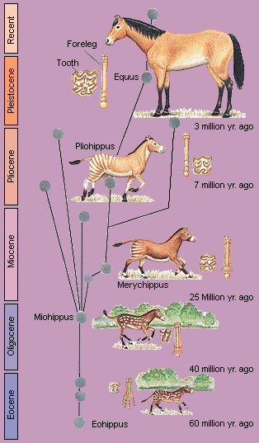
Phylogeny Tree/Branched Diagram
Outgroup

Slide 22
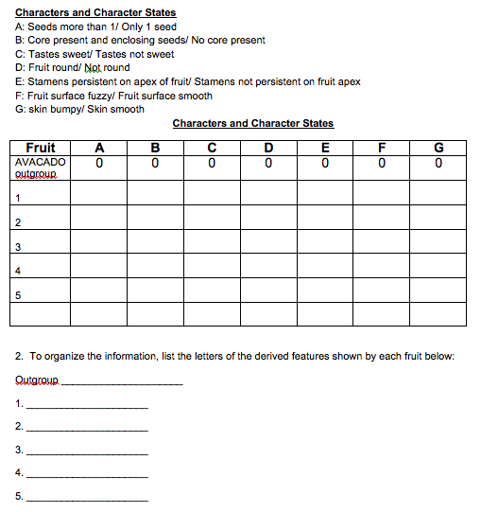
Taxonomy: Phylogeny Reconstruction

Slide 23
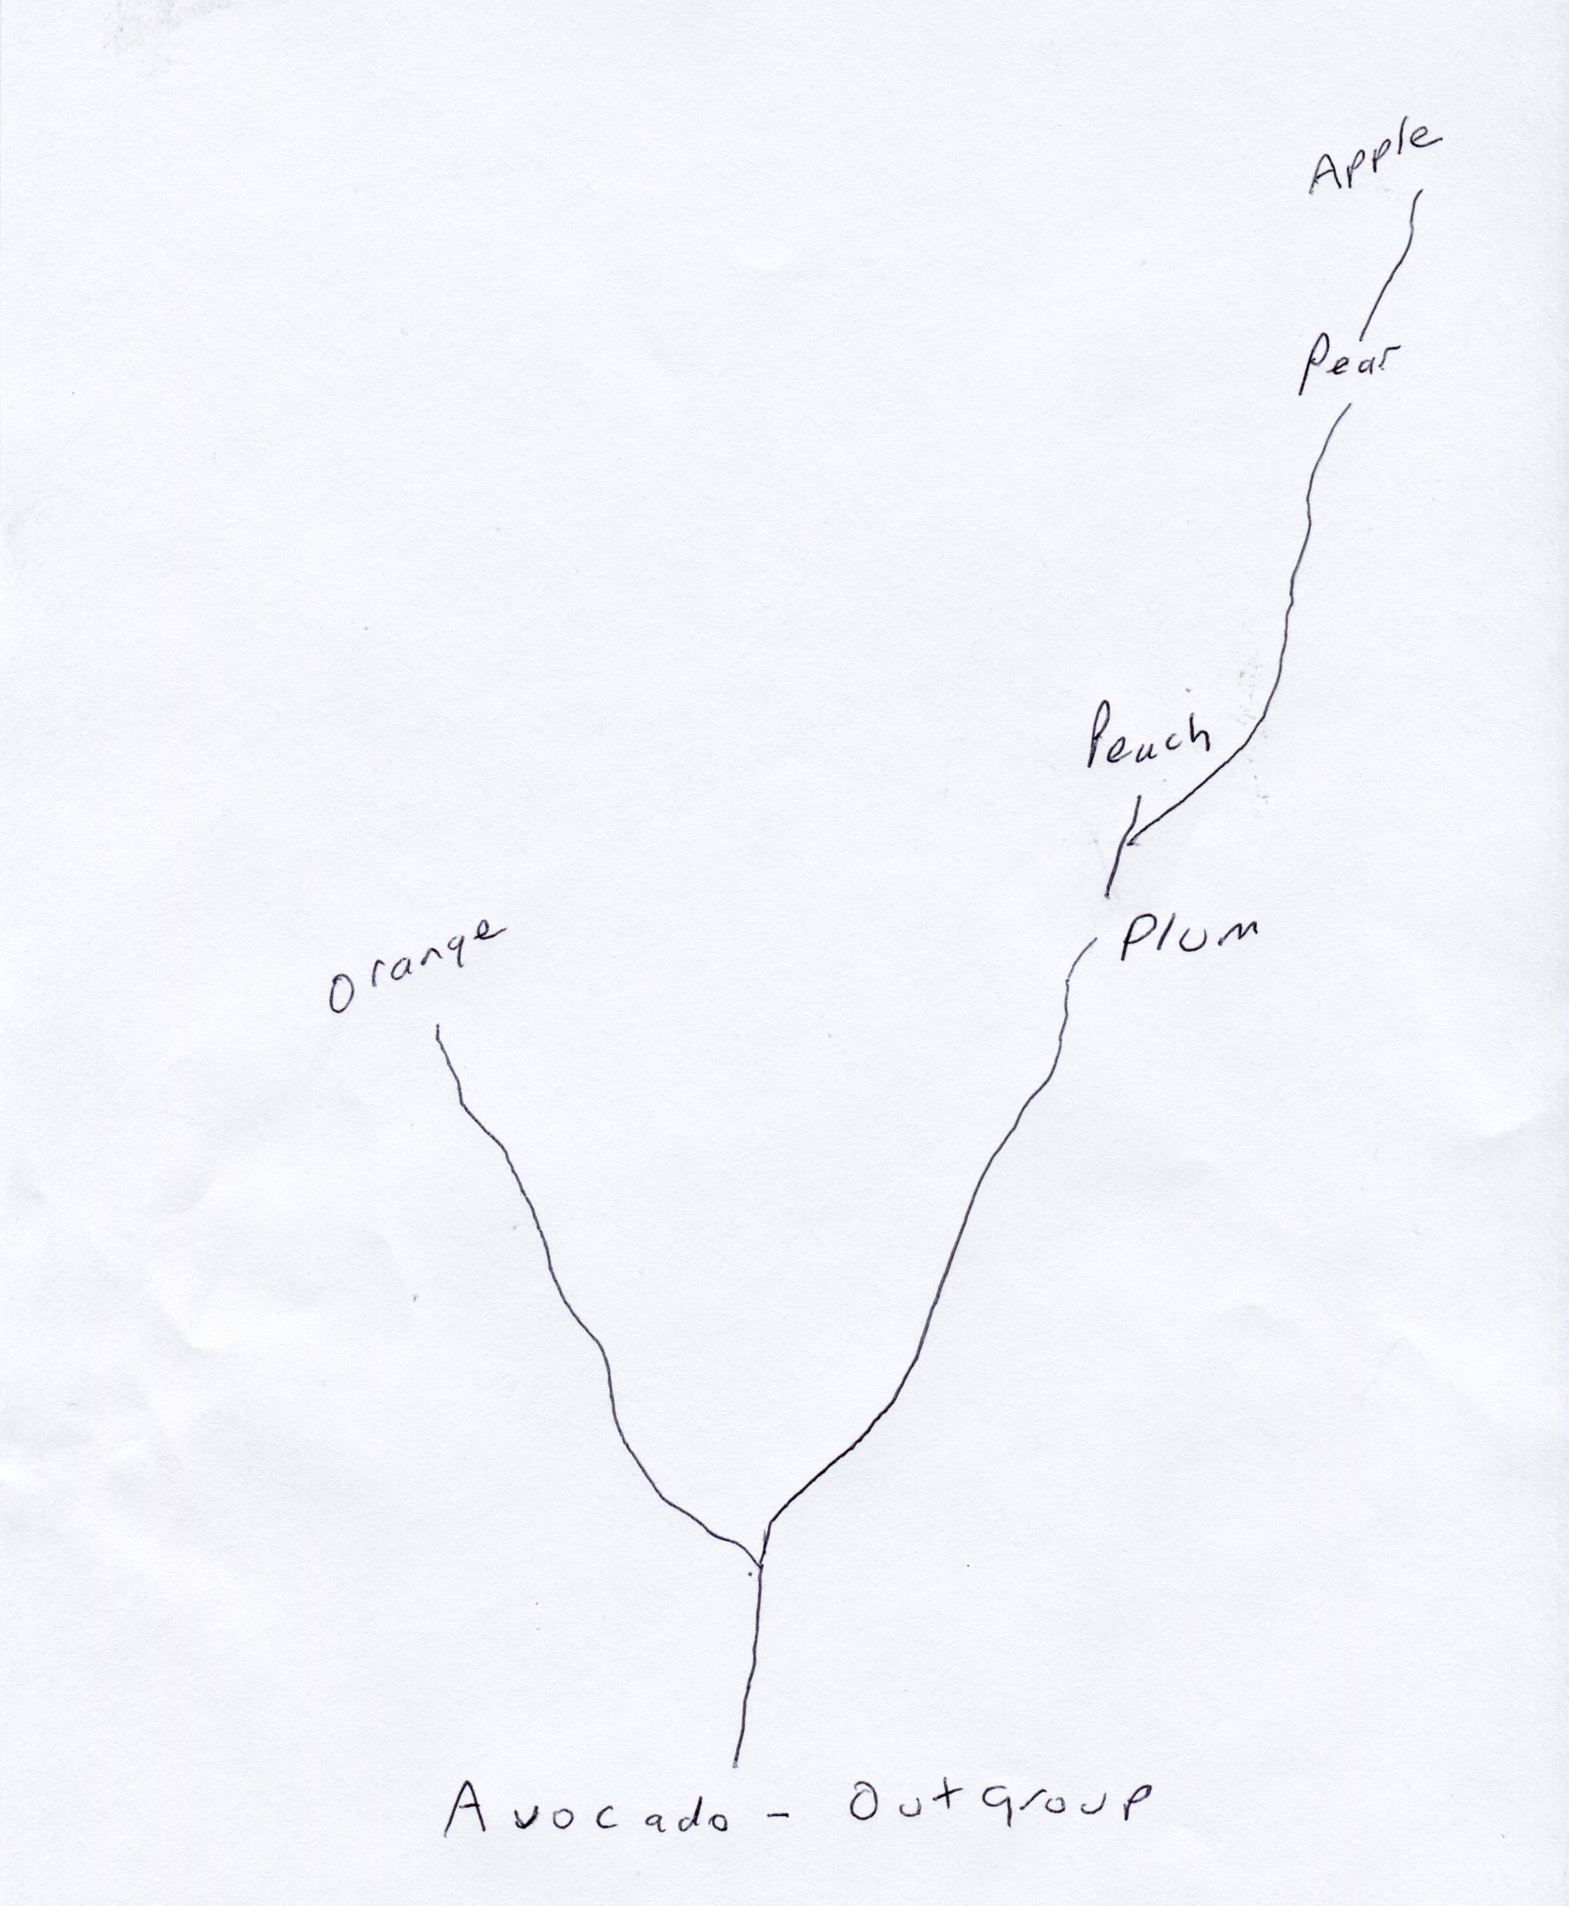
Phylogeny

Slide 24
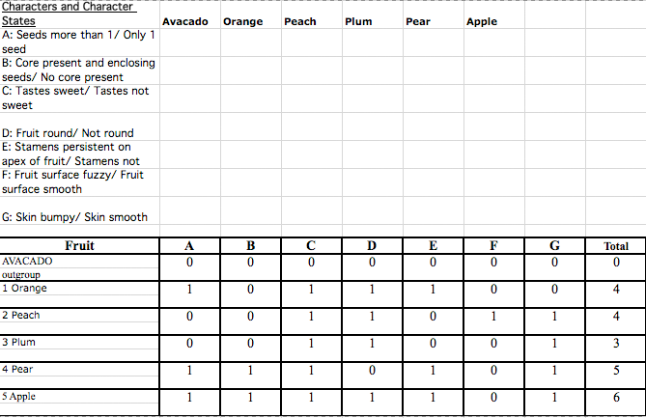

Slide 25
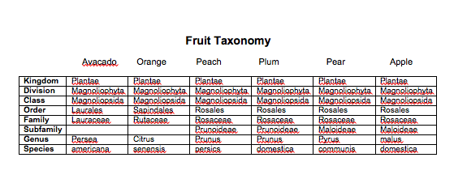
Taxonomy: Phylogeny Reconstruction

Slide 26
KEY CONCEPTS
Diversity of life—millions of species
We assume all living organisms evolved from a single source and diverged into the various kinds of organisms.
We need some way to organize this diversity
Classification
Two major systems of Classification
  Hierarchical
  Phylogentic

Slide 27
HIERCHICAL PHYLOGENETIC
Typically based on physical or metabolic characteristics
The general rule is that the more similar two organisms are, the more closely they are related
The taxa are somewhat arbitrary—determined by “experts” on a particular group
The species is more objective—organisms that can interbreed and produce fertile offspring
The traits or characteristics have a genetic basis
As more was learned about genetics, systems of classification were developed based on the similarity of genes (DNA, RNA or protein sequences)

Slide 28
Bead Bug Activity
Bead Bug Activity* Directions
During this laboratory exercise you will observe the evolution of a hypothetical population of "bead bugs". It is necessary for you to simulate the process of evolution by means of natural selection rather than observe it directly because of the time involved (from a few years to millions of years, depending on the organism) for the event to occur naturally. You have available to you, a species of insects, "bead bugs" (represented by beads) and the environment in which the bug lives (cloth). The following are some relevant facts about "bead bug" biology.
• Bead bugs live in meadows and feed on the pollen of flowers. The only death in a population is due to predation by birds. Each year, birds eat about one half the total population of bugs.
• Bead bugs reproduce just once a year in June. Reproduction is asexual. Each parent produces one offspring. You will simulate four generations of bead bugs by repeating 4 times this cycle of predation and reproduction.
Setting Up
1. Variation among individuals is characteristic of organisms of the same species. Observe the bead bugs. What are some of the differences between individual bead bugs?
2. You will be working with a population of bead bugs that live in a meadow. You will start with 40 bead bugs. Count 20 Blue Beads and 20 Yellow Beads and scatter them randomly on the meadow area.
3. On your data table, please enter 20 blue and 20 yellow for 1st generation under the "Before Predation" part of the table.

Slide 29
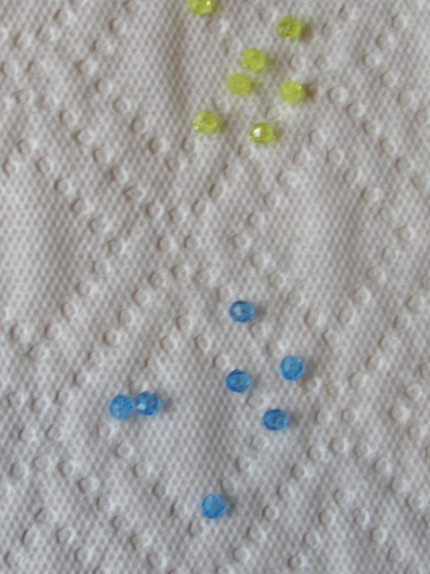
Bead Bug Activity

Slide 30
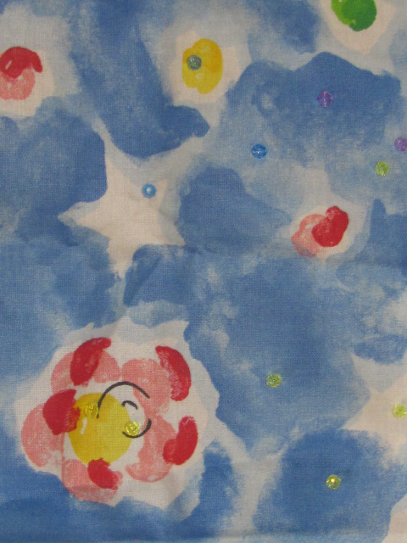
Bead Bug Activity

Slide 31
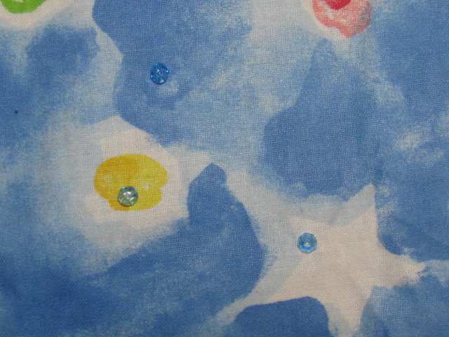
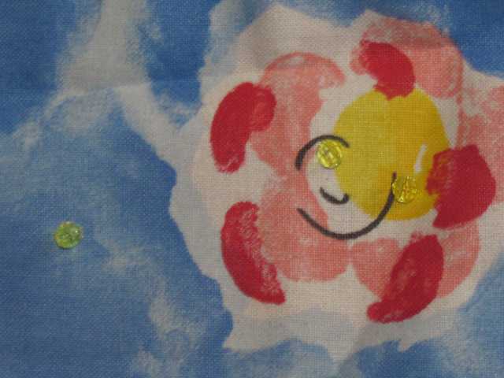
Bead Bug Activity – Adapted to Environment, Environment Selects

Slide 32
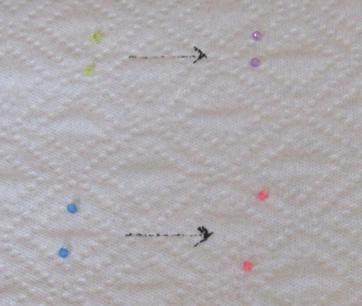
Bead Bug Activity - Mutation

Slide 33
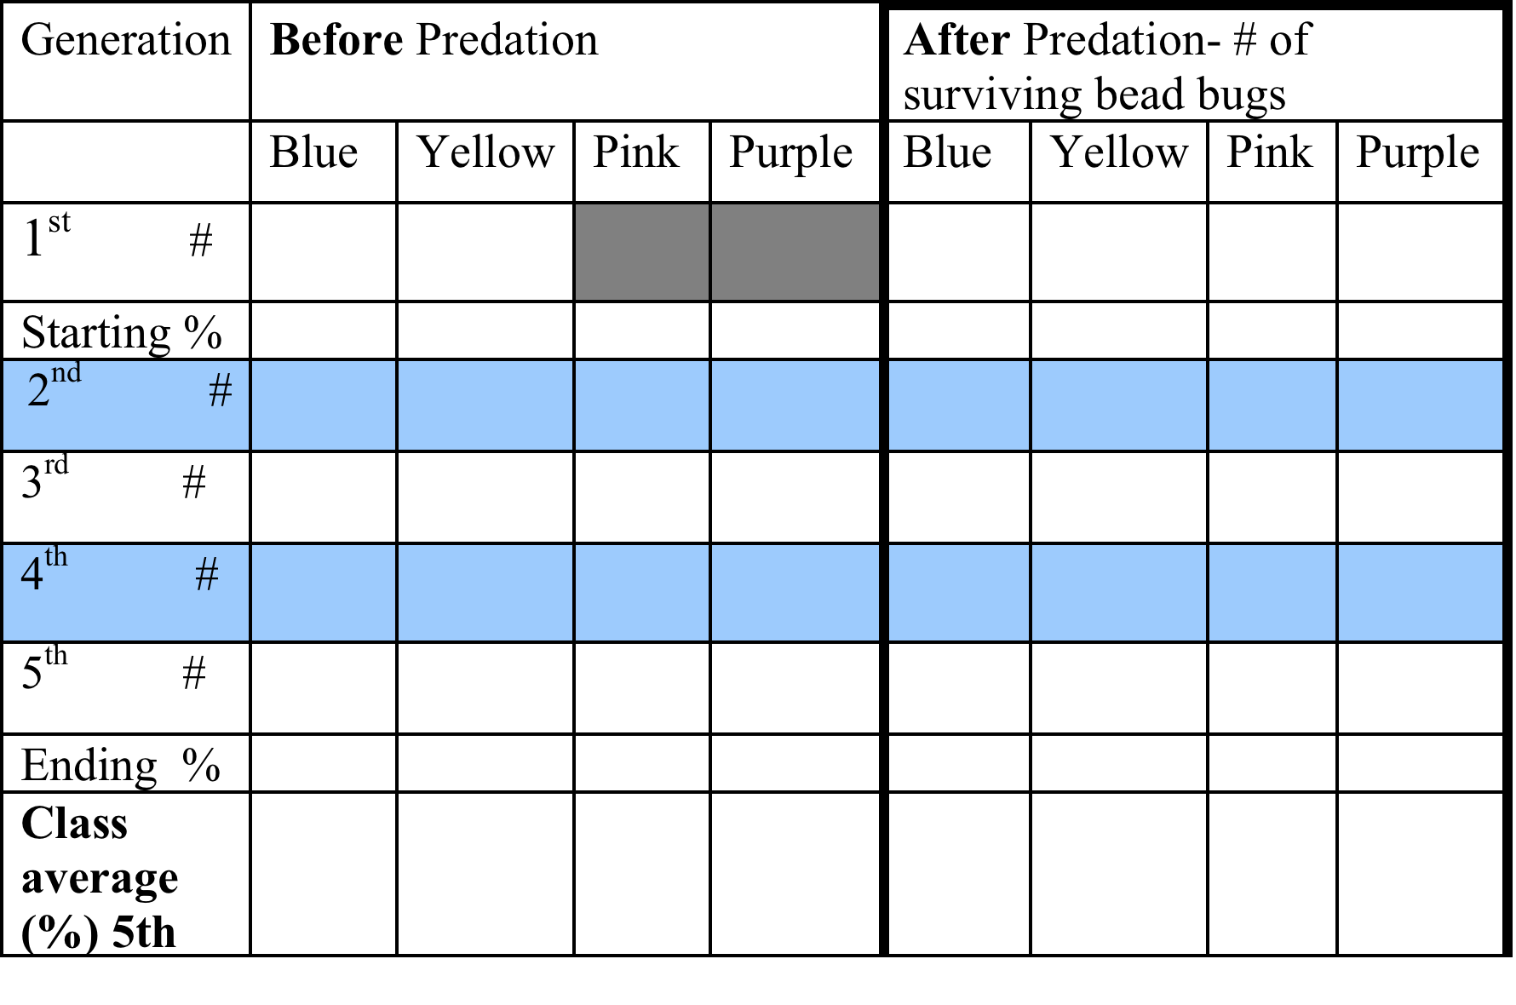
Bead Bug Activity

Slide 34
Evolution by Natural Selection
Steps:
Organisms tend to overproduce – producing a struggle for resources (food, space, mates, etc.)
Individuals vary in some traits.
Some of the differences in traits are passed along to offspring.
  This requires a genetic basis to the trait
  The trait is thus heritable
  (more…)

Slide 35
Contact Information
Bates Mandel 21 PSTEM bmandel@21pstem.org
Susan Holmes The Franklin Institute Science Museum sholmes@fi.edu

