Slide 1
Center Overview
F. Joseph Merlino
Principal Investigator
The 21st Century Center for Research and Development
in Cognition and Science Instruction
Funded by: Grant R305C080009 to The 21st Century Partnership for STEM Education. The opinions expressed are those of the authors and do not represent views of the U.S. Department of Education

Slide 2
The 21st Century Center for Research and Development in Cognition and Science Instruction Partners
The 21st Century Partnership
for STEM Education

Slide 3
Purpose & Objective
Purpose of this Center:
To develop specific theoretically driven modifications to existing middle school science curricula
To conduct a systematic series of studies to test and refine such strategies for improving the design of curricula
Objective:
To improve current curricula and identify general principles for the design of curriculum that could be easily applied to other science curricula to improve student learning.

Slide 4
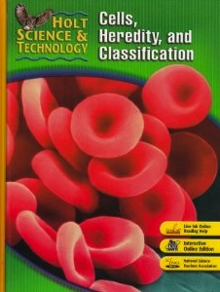
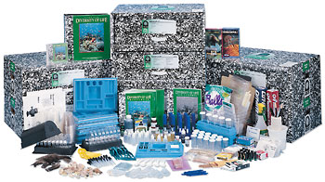
The Design Challenge
Textbook
Kit based
Curriculum | Holt | Full Option Science System (FOSS)
Biological Sciences | Cells, Heredity, & Classification | Diversity of Life
Earth Sciences | Inside the Restless Earth | Earth History | Weather and Water
Physical Sciences | Introduction to Matter | NA

Slide 5
Development Timeline
Units 1+2
Units 3,4,5, 6
Analyze unit
Revise unit
Pilot test
Revise unit
Cohort 1
(Revise unit)
Cohort 2
Yr 1
Analyze unit
Revise unit
Pilot test
Revise unit
Cohort 1
(Revise unit)
Cohort 2
Yr 2
Yr 3
Yr 4

Slide 6
Cognitive Science Senior Team Members
Chris Schunn, Co-PI Assoc. Professor of Psychology, Intelligent Sys Program, Learning Sciences and Policy
Research Scientist, LRDC
Kalyani Raghavan LRDC Research Associate, and Director of Model Assisted Reasoning in Science project
Tim Nokes Asst. Professor, Department of Psychology Director, Cognitive Science Learning Laboratory
Nora Newcombe, Co-PI Professor of Psychology and PI of the NSF Spatial Intelligence and Learning Center
Jennifer Cromley, Co-PI Asst Professor of Educational Psychology, 2010 recipient Presidential Early Career Award for Scientists and Engineers (PECASE)
Chris Massey, Co-PI Director for Research and Education, Institute for Research in Cognitive Science

