Slide 1
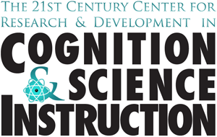
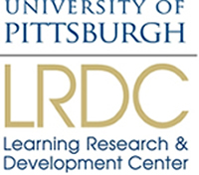
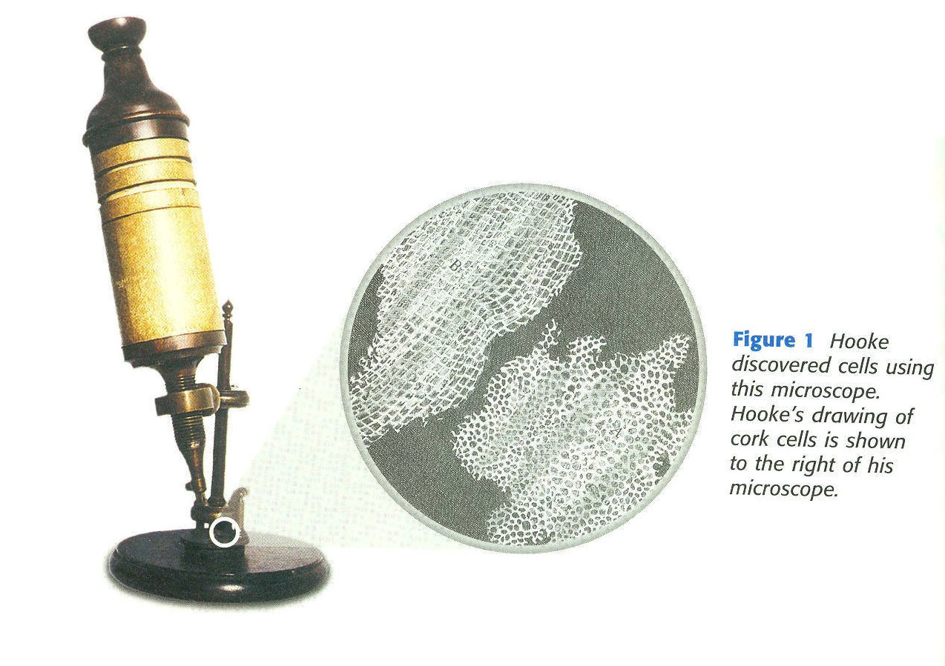
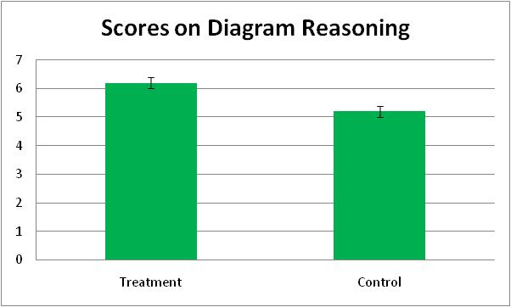
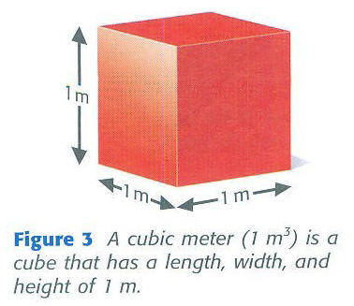
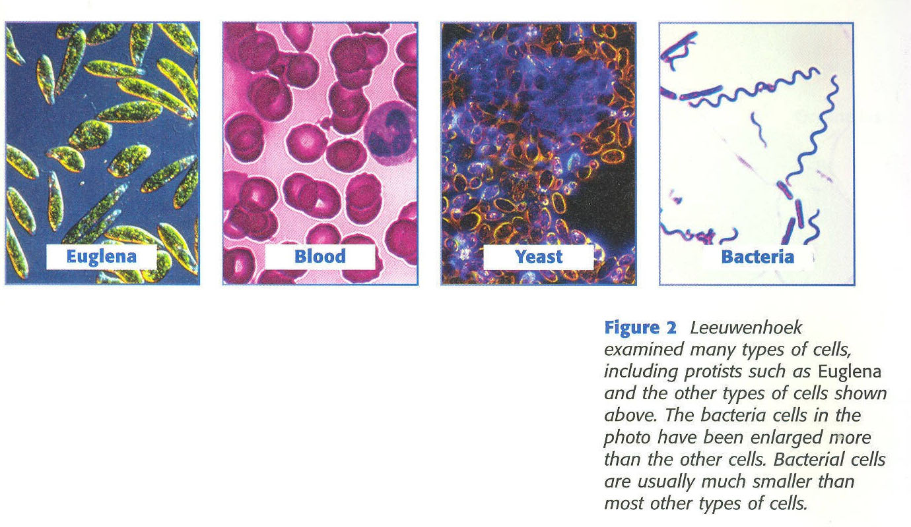
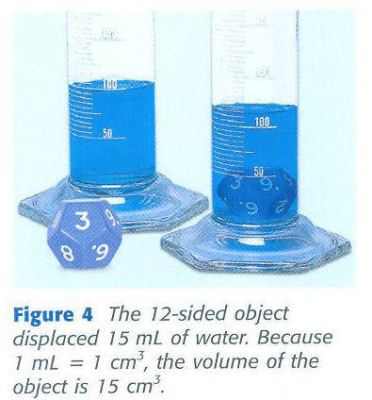
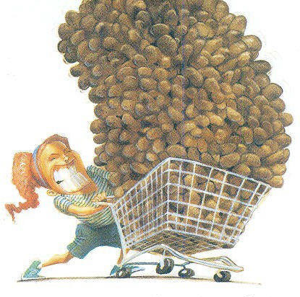
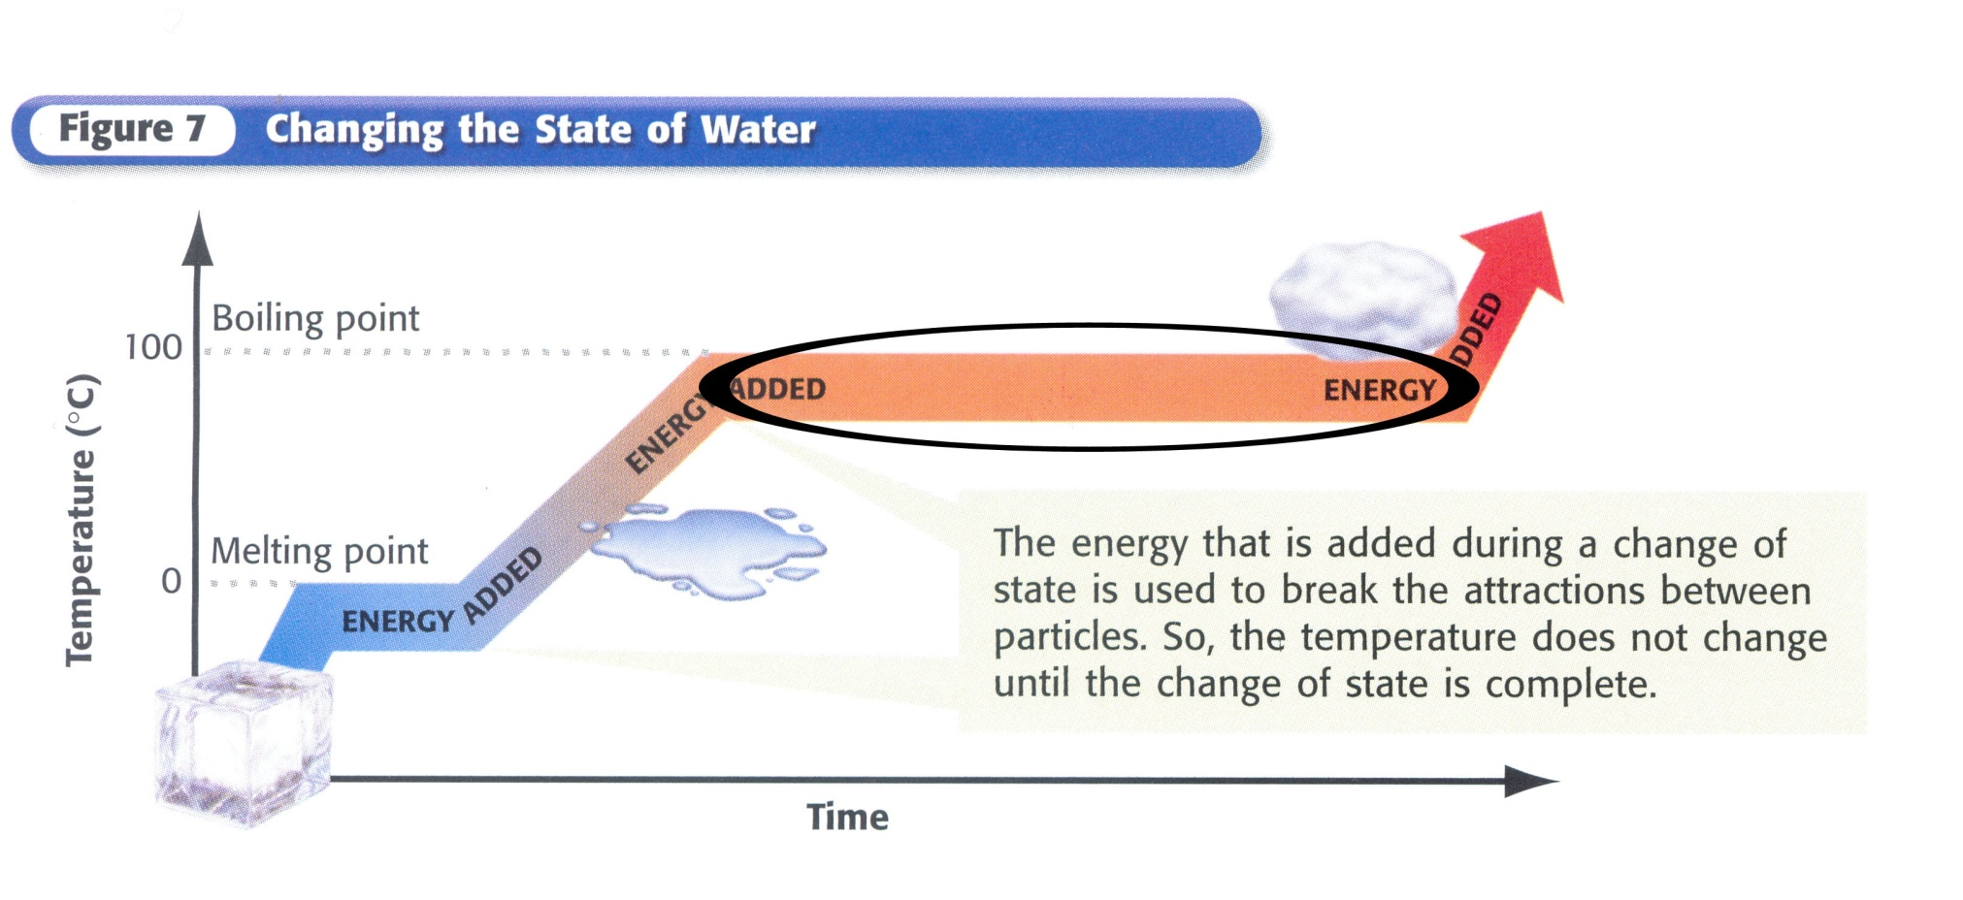
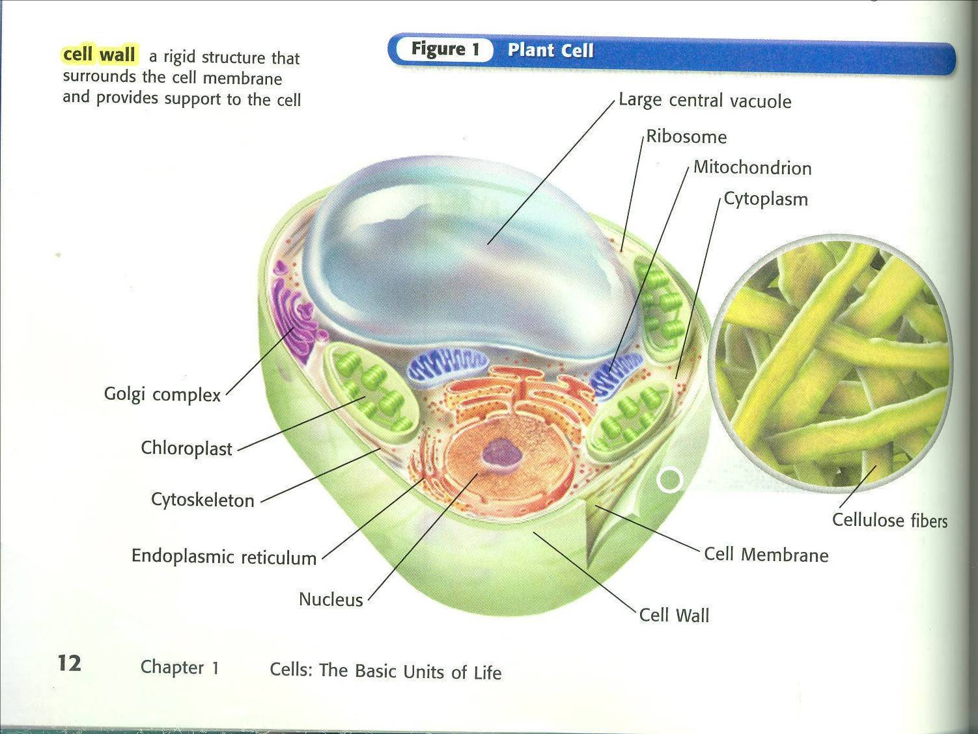
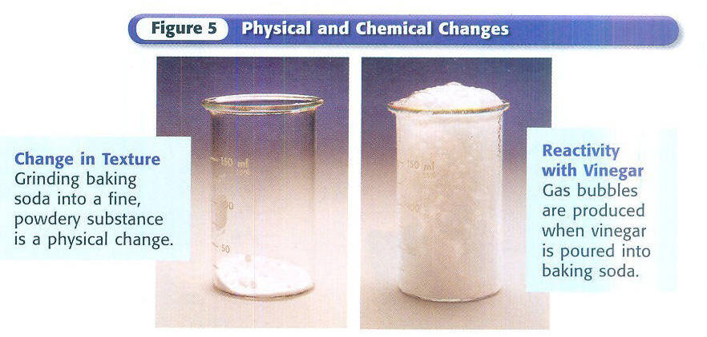
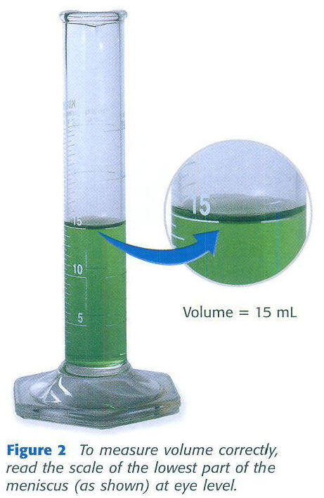
Improving Diagrammatic Reasoning In
Middle School Science Students
Jennifer Cromley
Nora Newcombe
Ted Wills
Abstract
Middle school students who completed an 11-week diagrams interventions showed greater achievement in content and in transfer of diagrammatic reasoning that did students in no-treatment control groups.
Christian Schunn
Timothy Nokes
Christine Massey
Temple University
University of Pennsylvania
Curriculum | Biological Sciences | Earth Sciences | Physical Sciences
Holt (Textbook) | Cells, Heredity, and Classification | Inside the Restless Earth | Introduction to Matter
FOSS (Hands-on) | Diversity of Life | Earth History Weather & Water | NA
Visualizations
Methods
Results
Zoom out
Research Design
Two pilot teachers delivered the intervention in 6 intact classrooms (N = 165).
Treatment students (n = 99) outscored control students (n = 66), M_{t} = 6.2, SD_{t} = 1.8; M_{t} = 5.2, SD_{t} = 2.3, d = .5.
One-way ANOVA showed a significant main effect of treatment
Followup exploratory analyses on ethnicity showed
A significant main effect of ethnicity; non-White students scored lower than White students
A non-significant advantage of the treatment over control for non-White students (d = .24)
Followup exploratory analyses on sex showed
No significant sex differences or sex X treatment interaction (M_{M} = 5.4, M_{F} = 5.9)
Followup exploratory analyses on Special Education status showed
A significant main effect of Special Ed status; Special Ed students scored lower than Regular students
A significant advantage of the treatment over control for Special Ed students (d = .59)
Pilot Field Test Data
The circle located above and to the right of the microscope illustrates what it would look like if one was looking into the microscope.
This image also uses a “zoom-out” convention in that part of the image is at a much higher level of magnification than the rest.
Condition | Curriculum | Professional Development
Cognitive Science | Modified curriculum | PD on modifications / cogsci principles (some content)
Content PD | Existing curriculum | Matched # hours of PD focused on underlying science content
Control | Existing curriculum | None
+
Visualization Conventions Addressed
Test
Arrows
Relative Scale & Magnification
Relative scale and magnification
Biology
Earth History
The bacteria is magnified much more than the other slides. A red blood cell can be up to ten times larger than some bacteria even though the image makes it seem that the bacteria is larger.
+
Labels
Captions
Diagram vs. Real
Symbols
Color Keys
Color
Color is being used here to show the different organelles. The reason that this organelles have different colors is to make it easier to differentiate so that it will be easier to understand the structure of the cell. They do not accurately represent their true colors.
Labels
Enlargements
+
Enlargement

