Slide 1
Joe Merlino
Chris Schunn
Tim Nokes
Nora Newcombe
Jennifer Cromley
Christian Schunn
LRDC
Temple University
Andy Porter
Laura Desimone
Graduate School of Education
Chris Massey
University of Pennsylvania

Slide 2
Goal
Systematically applying cognitive science principles to improve existing middle school science curricula
Principles:
Contrasting cases
Visualizations
Prior Knowledge
Spaced testing
Curricula
Textbook (Holt)
Hands-on (FOSS)
X

Slide 3
Modify 3 units / Curriculum
Curriculum | Biological Sciences | Earth Sciences | Physical Sciences
Holt (Textbook) | Cells, Heredity, & Classification | Inside the Restless Earth | Introduction to Matter
FOSS (Hands-on) | Diversity of Life Populations & Ecosystems | Earth History | NA

Slide 4
Effectiveness Experiment
Condition | Curriculum | Professional Development
Cognitive Science | Modified curriculum | PD on modifications / cogsci principles (some content)
Content PD | Existing curriculum | Matched # hours of PD focused on underlying science content
Control | Existing curriculum | None
Experiment implemented separately for each curriculum
Randomly assign schools to condition (stratified within district)
Holt: School District of Philadelphia
FOSS: Pittsburgh Public, Delaware Schools, ???
30 schools per condition x 2 curricula = 180 schools = X0,000 students
Track students for 2 years (through 3 units)
Student measures:
end-of-unit tests (closely aligned)
state science tests (loosely aligned)

Slide 5
Contrasting cases (Same? Different?)

Slide 6
T. rex
lived 65 to 68 million yrs ago
ate other animals
found on land
move by walking upright
made up of many different kinds of cells
each cell has nucleus
move
ingest food found in environment
reproduce sexually
found in African rainforests
also walks on all fours
eats fruits, leaves, and small animals
found in marine environments
moves by swimming
eats plankton
Barnacle
Bonobo

Slide 7
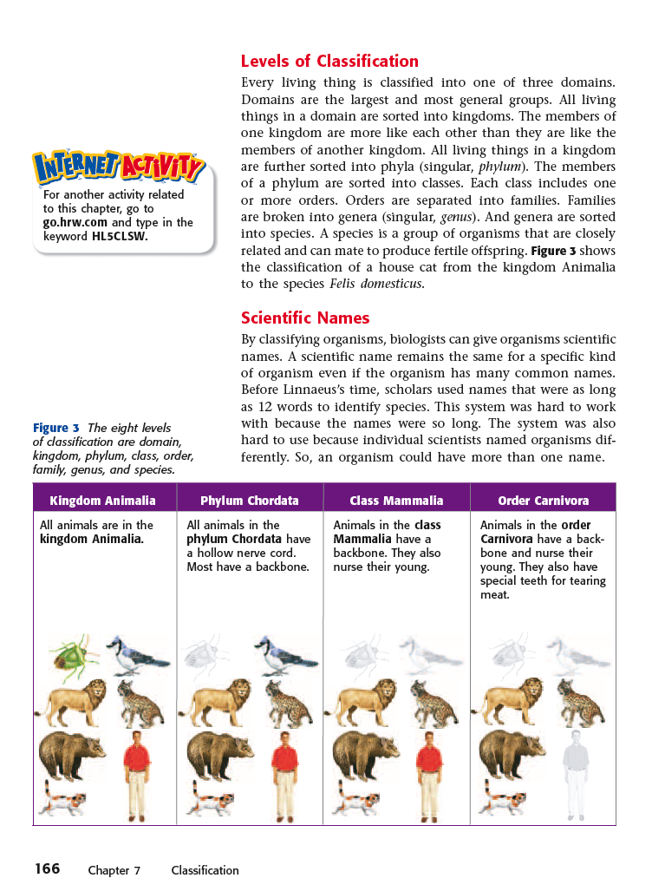
Followed by reading/lecture

Slide 8
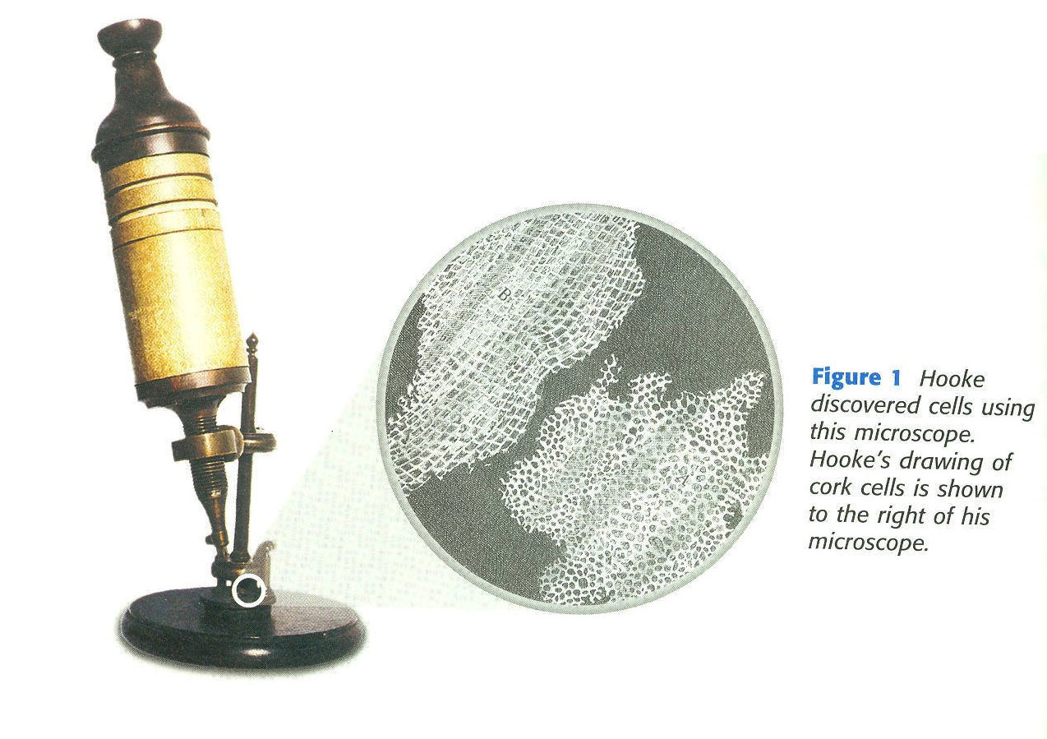
Visualizations
E.g., Help with zoom outs
The circle located above and to the right of the microscope illustrates what it would look like if one was looking into the microscope.
This image also uses a “zoom-out” convention in that part of the image is at a much higher level of magnification than the rest.

Slide 9
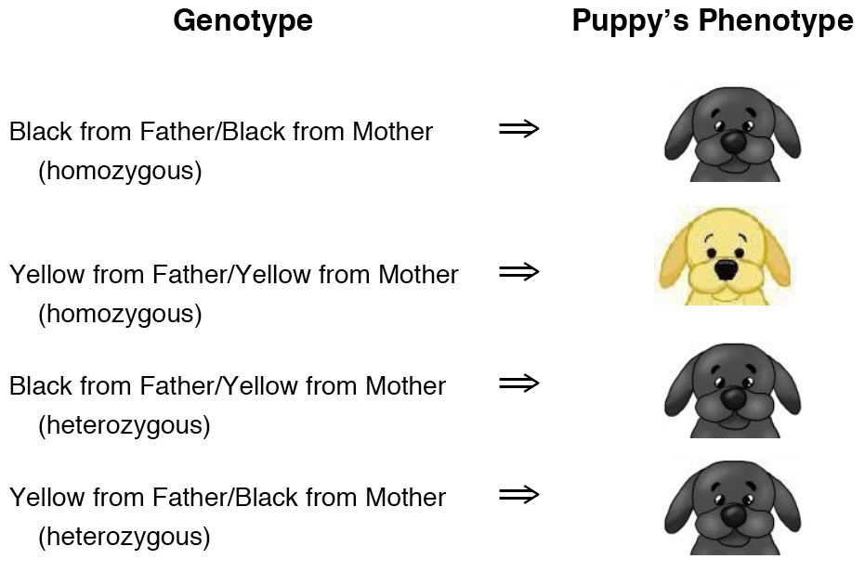
Prior Knowledge
E.g., Children confuse genotype & phenotype
How come two black labs could have a puppy with a yellow phenotype but two yellow labs could not have a puppy with a black phenotype?
Can a puppy with a black phenotype have a yellow allele as part of its genotype?
Why or why not?

Slide 10
Development process
Units 1+2
Units 3,4,5, 6
Analyze unit
Revise unit
Pilot test
Revise unit
Cohort 1
(Revise unit)
Cohort 2
Yr 1
Analyze unit
Revise unit
Pilot test
Revise unit
Cohort 1
(Revise unit)
Cohort 2
Yr 2
Yr 3
Yr 4

Slide 11
Issues
No free time: What gets deleted?
Which elements are worthy of emphasis (and who/how decide)?
What role of content reviewers?
Modify general curriculum or enacted curriculum?
What is fidelity of implementation (activity or principle)?

Slide 12
IES Practice Guide & CaSE Cognitive Science Principles
Strong + Moderate Practice Guide Recommendations
Interleave worked example solutions and problem-solving exercises
Ask deep explanatory questions
Combine graphics with verbal descriptions
Connect and integrate abstract and concrete representations of concepts
Using quizzing to promote learning
Use pre-questions to introduce a new topic
Use quizzes to re-expose students to key content
Space learning over time
CaSE CogSci Principles Guiding Modifications
Contrasting cases (Pitt)
Introduce key concepts through active comparison
Generate explanation questions to be answered through later activities
Revisit concepts in later readings
Visualizations (Temple)
Connect captions to figures
Explain figure conventions
Explain nature of abstractions in figures + diagrams
Prior Knowledge (Penn)
Evoke prior knowledge
Explicitly provide data/experiences which strongly contradict prior misconceptions
Distributed embedded assessments
Daily warm-up
Weekly quiz (lagged Qs) + review
End of unit + year cumulative exams

